Slide 1
Variable Types, Basic Operators, Number
Class 2

Slide 2
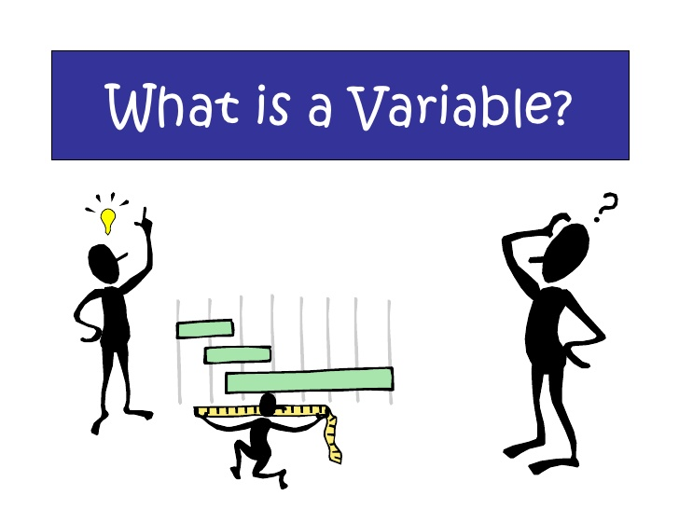

Variable
চলক
$A=πr^{2}$

Slide 3

Cont.….

Slide 4
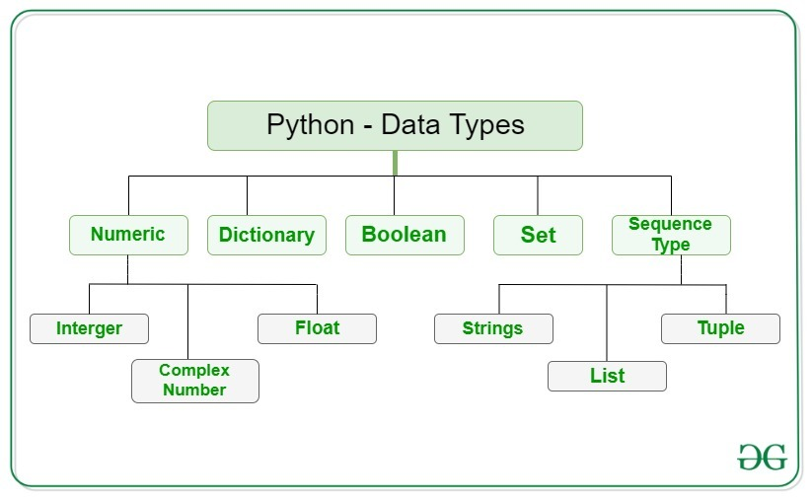
Data type
1. Integer
2. Float
3. Complex
4. String
5. List
6. Set
7. Tuple
8. Dictionary
9. Boolean

Slide 5
How to use variable ??
In other language
int a , b;
float c, d;
char e;
String f;
In Python
a = 1
b = 3.5
c = “NVIT”

Slide 6
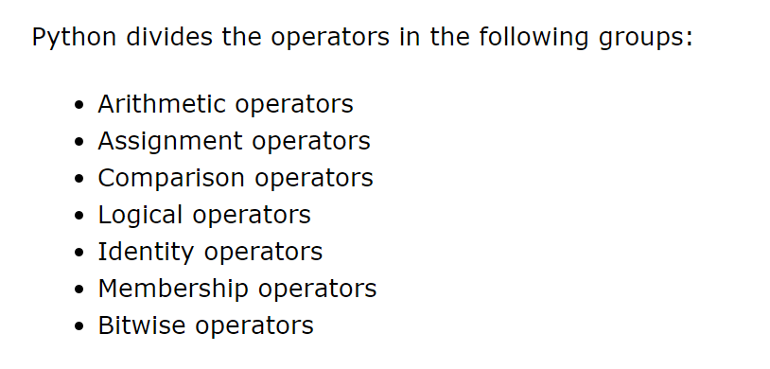
Operator

Slide 7
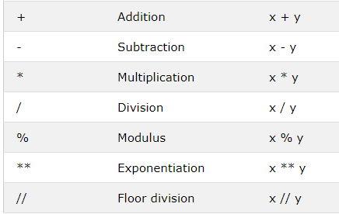
Python Arithmetic Operators

Slide 8
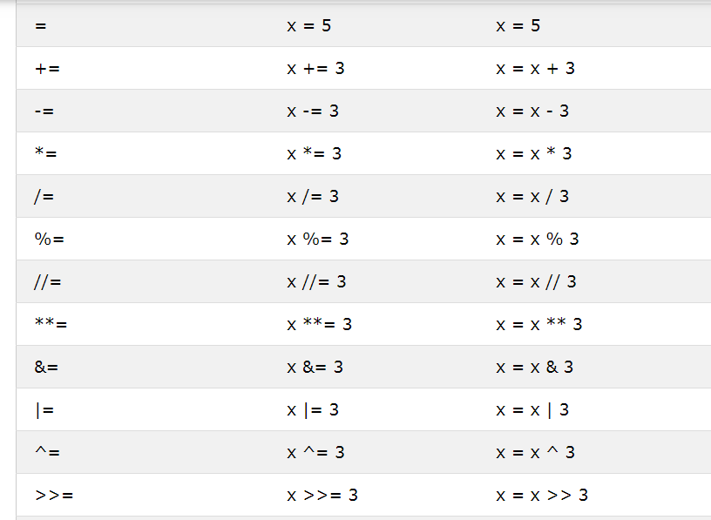
Python Assignment Operators

Slide 9
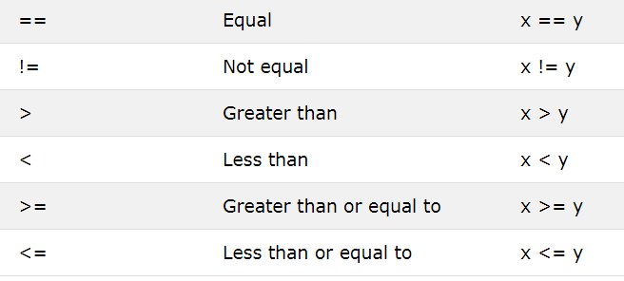
Python Comparison Operators

Slide 10
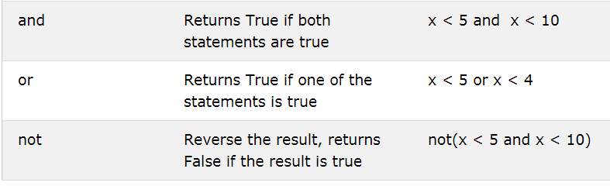
Python Logical Operators

Slide 11
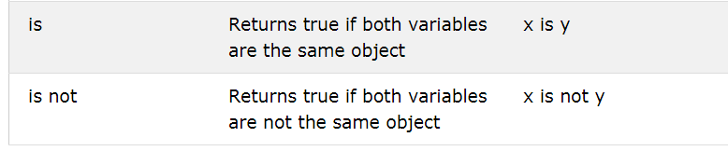
Python Identity Operators

Slide 12
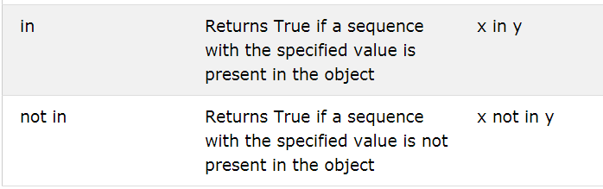
Python Membership Operators

Slide 13
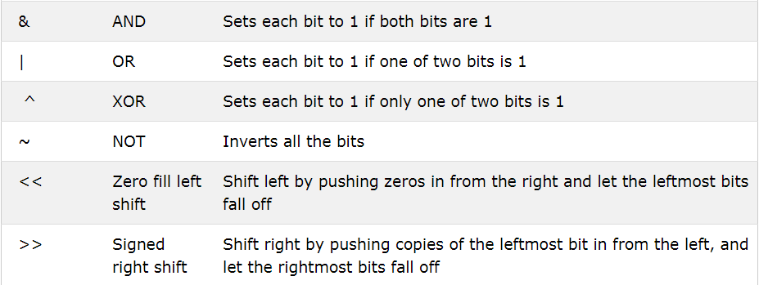
Python Bitwise Operators

Slide 14
Numbers
There are three numeric types in Python:
int x = 3
Float y = 3.5
complex z = 3j

Slide 15
Python Casting
int() - constructs an integer number from an integer literal, a float literal (by rounding down to the previous whole number), or a string literal (providing the string represents a whole number)
float() - constructs a float number from an integer literal, a float literal or a string literal (providing the string represents a float or an integer)
str() - constructs a string from a wide variety of data types, including strings, integer literals and float literals

Slide 16
Input and Output
Input()
Print()

Slide 17
let's start coding

Slide 18
Problems
Add three number
multiply 3 number
take five number from user and calculate average
you have sum of four number and you know the first three number. Find the missing number.
Your friend Has N number of Mangoes and he has M number of siblings. Find how many Mangoes left after he divided the mangoes among his siblings ?
A vehicle has reached Dhaka to Chittagong in 3h45M. Find it speed in KPM. Distance of Dhaka to Chittagong 248KM

